Slide 1

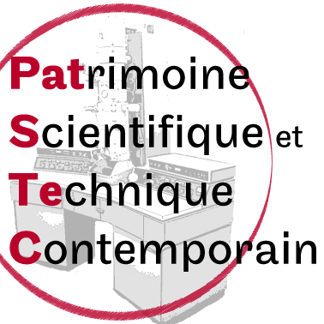
A national programme to save contemporary scientific and technical heritage
(Mission PATSTEC)
TEHNISKI MUZEJ -
-Ljubljana- 19 mai 2017
Catherine Cuenca

Slide 2
Sciences and techniques are present in many fields of our every day life : health, communication, energy and transport…
However their development is now subject to mixed feelings.
A dialog between science, technology and society is essential.

Slide 3
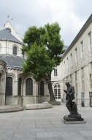
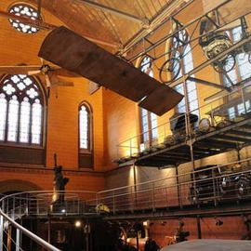
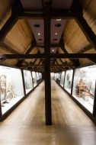
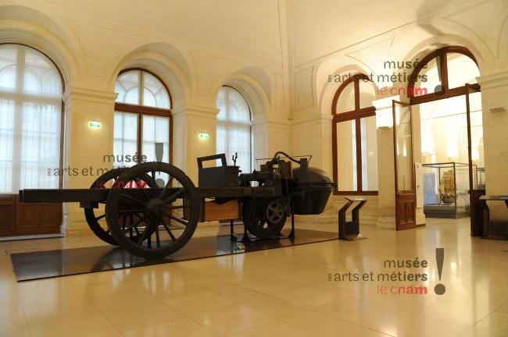
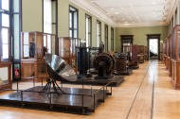

Slide 4
A national programme of safeguard in France
As a result of the previous experiences since1996 at a local french level, then regional level and now national level
➢ In April 2003, the Ministery of Research gave a « national mission » to the Musée des arts et métiers (Cnam-Paris), « the safeguard of contemporary scientific and technical heritage (60’s years) ».

Slide 5
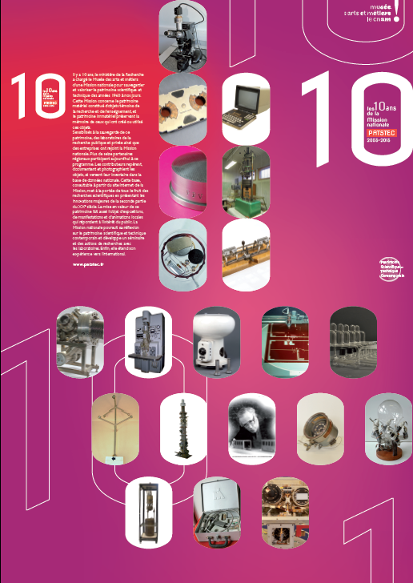
En 2013-2014

Slide 6
The objectives are
To get the universities research organizations and industrial firm aware of their part in locating, inventorying and documenting objects, storing them in adequate buildings and into a national database.
➢ To raise up the organization of a network, at a regional level, with a team round a project manager, and a scientific comittee with members from the different cultural, scientific and industrial organizations in the area.

Slide 7
To transfer our knowledge and our know-how by giving advices and expertise, but also by sharing tools with the partners of the network, such as the data base and the web site.
To develop and follow the national program in the french regions.
➢ To organize public events during the program.
Notes:
Expert- tise
RE- GIENS

Slide 8
This requires
to save the most representative scientific instruments of the last 60’s years, which are often thrown away from research laboratories and factories.
to save the know-how of the researchers who have participated around the sixties and the seventies to the creation of many research centers and industrial development, and who are know retiring.
Notes:
Who are retei iring know

Slide 9
What objects?
➢Material heritage : from the scientific instruments to the industrial products, with their documentation and corresponding manuscripts.
➢Immaterial heritage : the living memory of researchers can be gathered through interviews which present the know-how of the people who have invented and used these objects.

Slide 10
Organization of the programme
- A national coordination team in the Musée des arts et métiers, Cnam Paris
- A scientific european committee
- technical research groups (recommend what to keep from the last forty years)
- a juridical research group (relationship between the object and the institute is not always clear, who is the owner)
Notes:
Groups working on

Slide 11
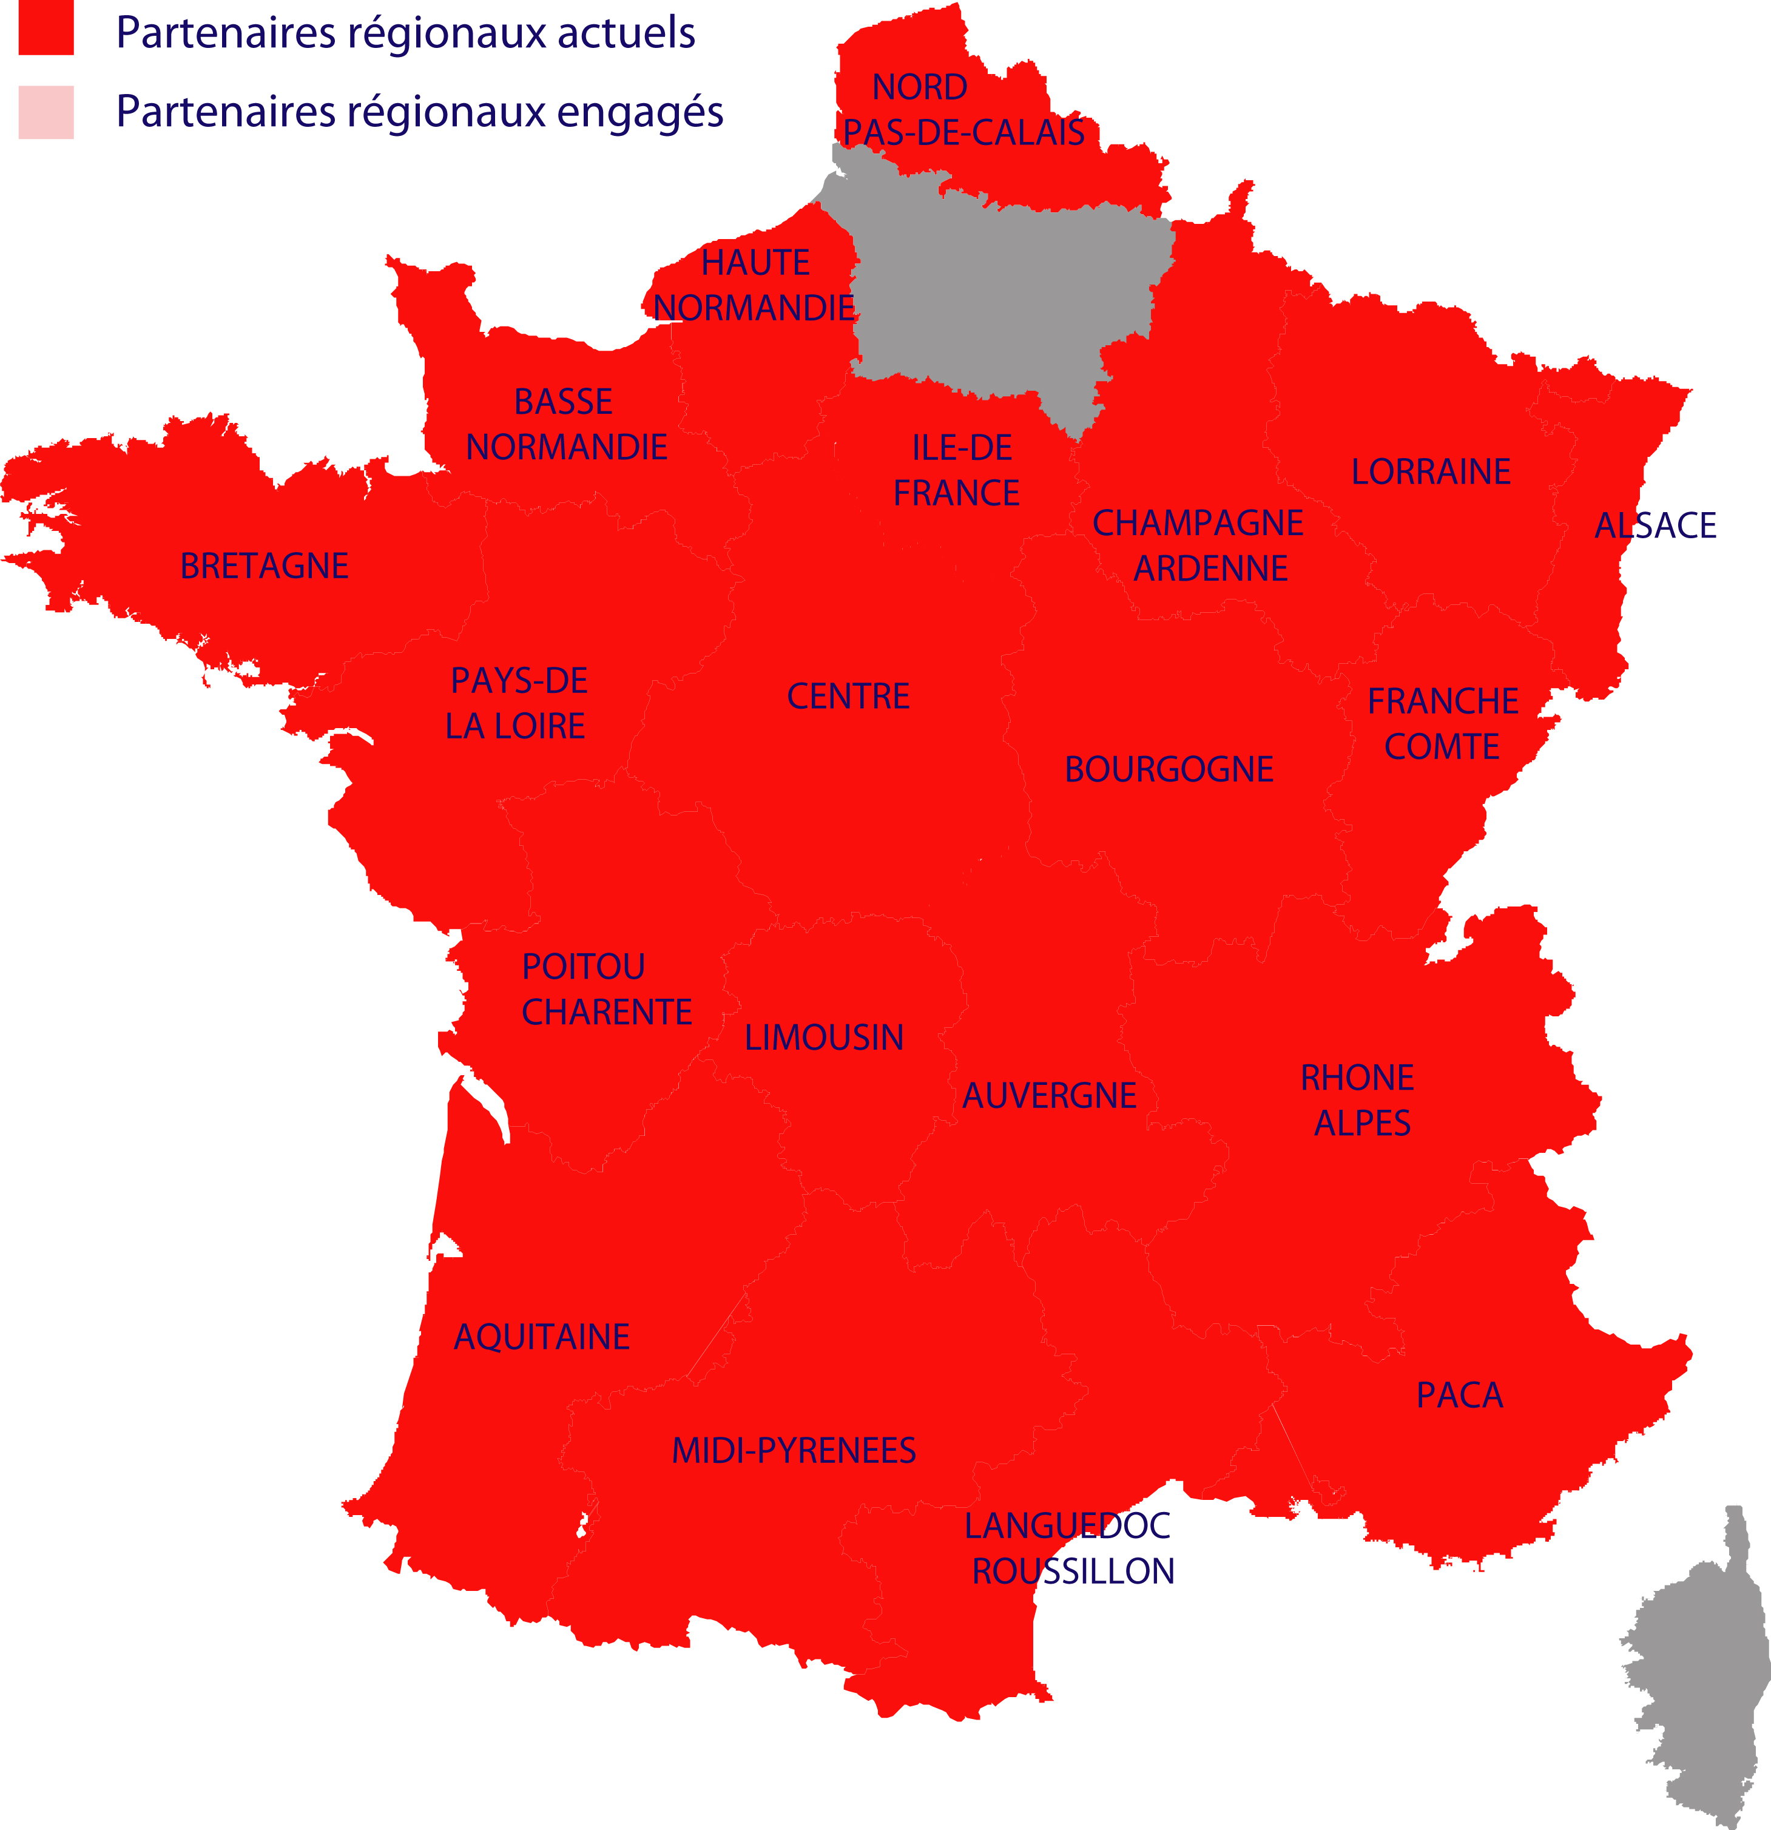

Slide 12
17 régions are invested in the network in France
Research organisms partners : CNRS, CEA, CERN, Météo-France,…
Industrials partners : Essilor, Michelin, Fondation EDF…
18 000 objects documented in the national website and 60 000 photographies and medias
www. patstec.fr
about 120 to 150 objects documented /per region/per year/per partners

Slide 13
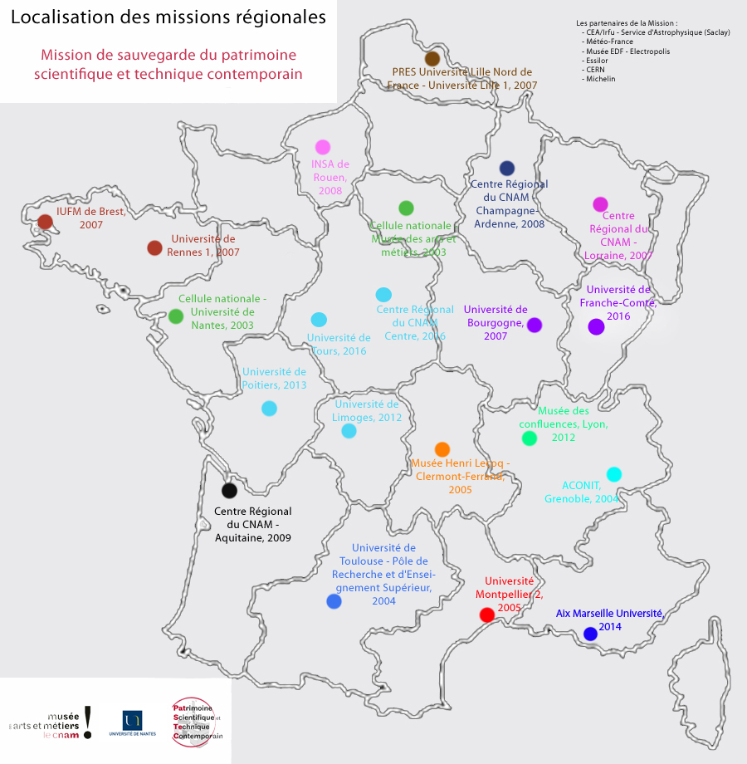
Bilan des fiches visibles sur le site

Slide 14
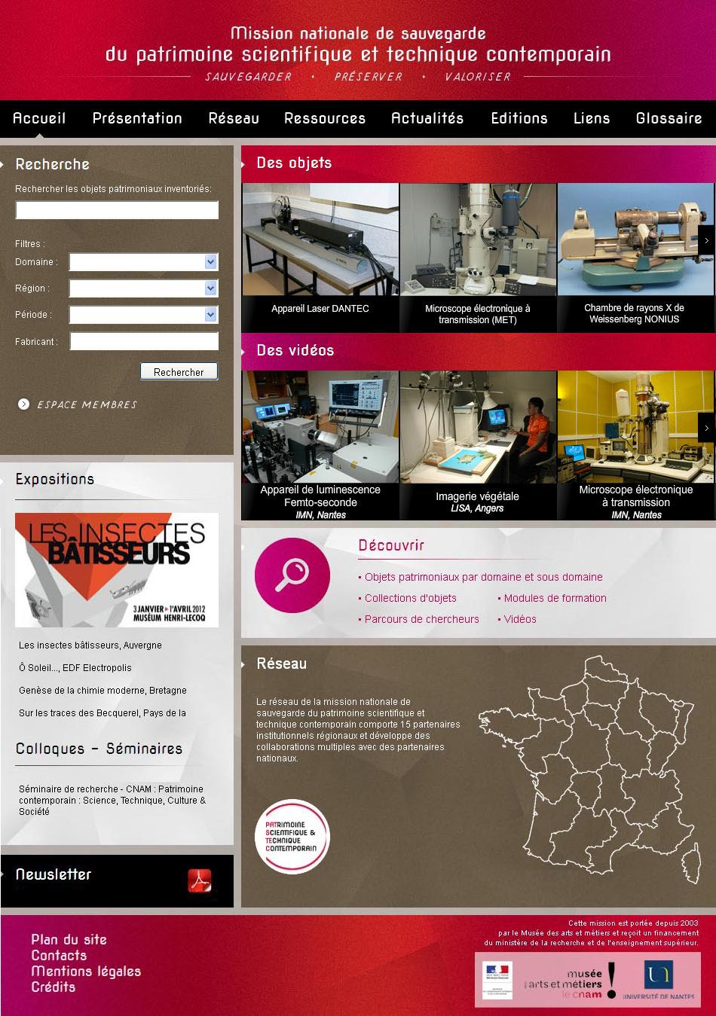
National Data base and Website www. patstec.fr

Slide 15
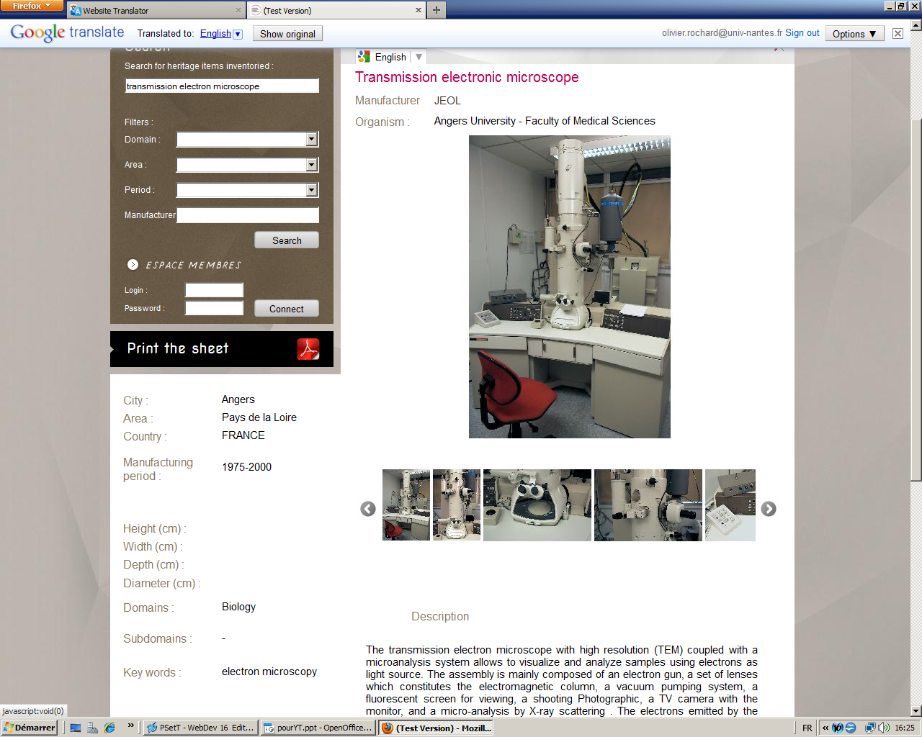

Slide 16
The importation of new inventory in the patstec website is following a process :
1. Each regional partner is in charge of feeding his own database.
2. After a validation step, some of the inventories are transfered to the national database server in order to put the information in a common structure. This means data are now in the same format.
3. The validated data are then transfered on to the web server. They are finaly indexed in order to be found by the search engine.

Slide 17
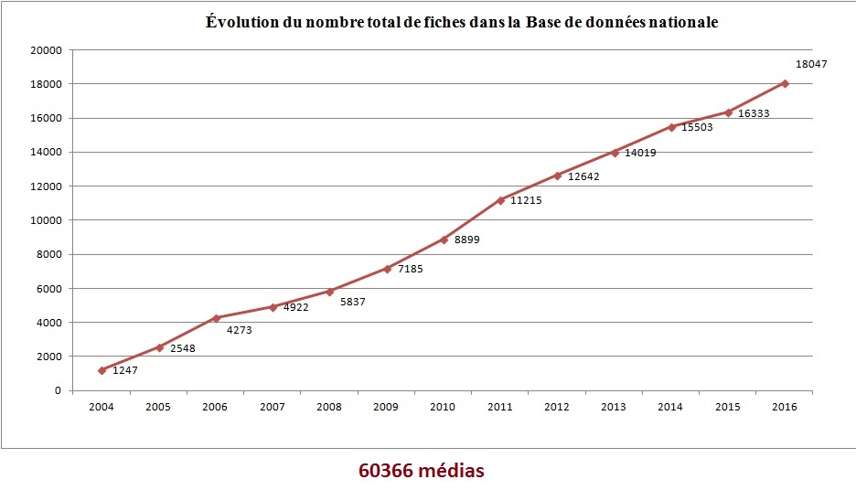

Slide 18
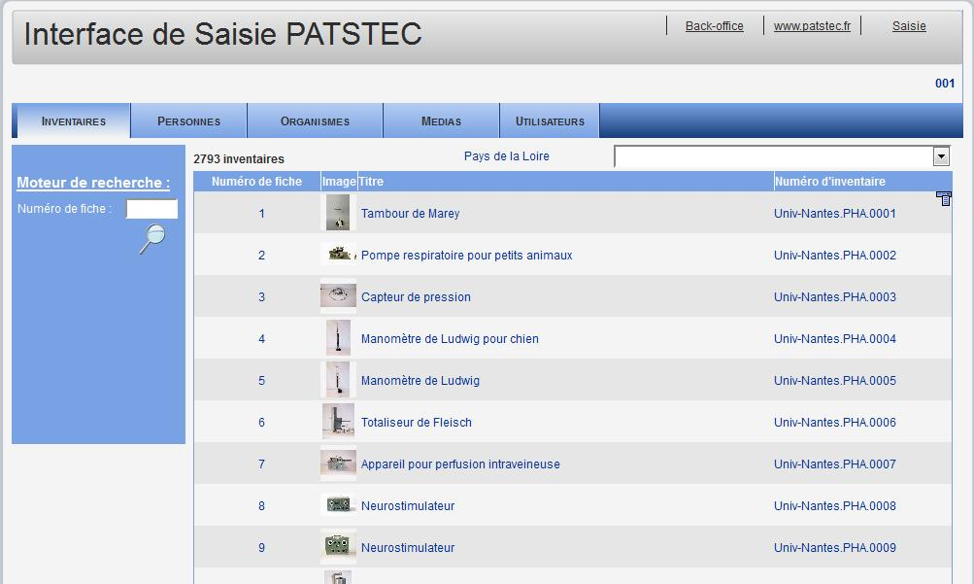
Liste des inventaires

Slide 19
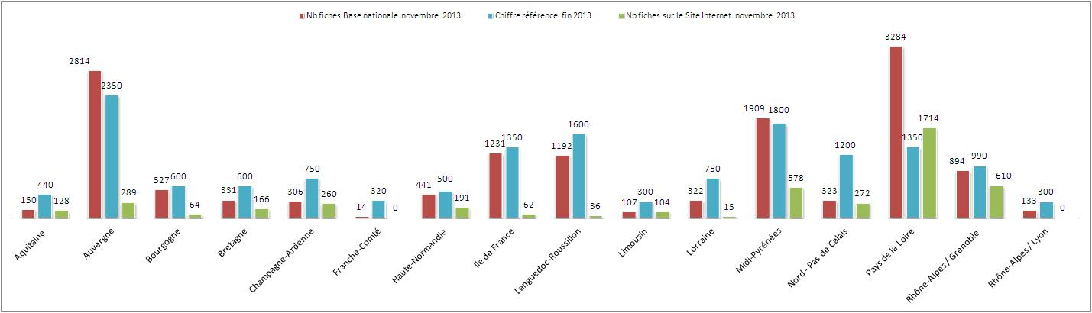

Slide 20
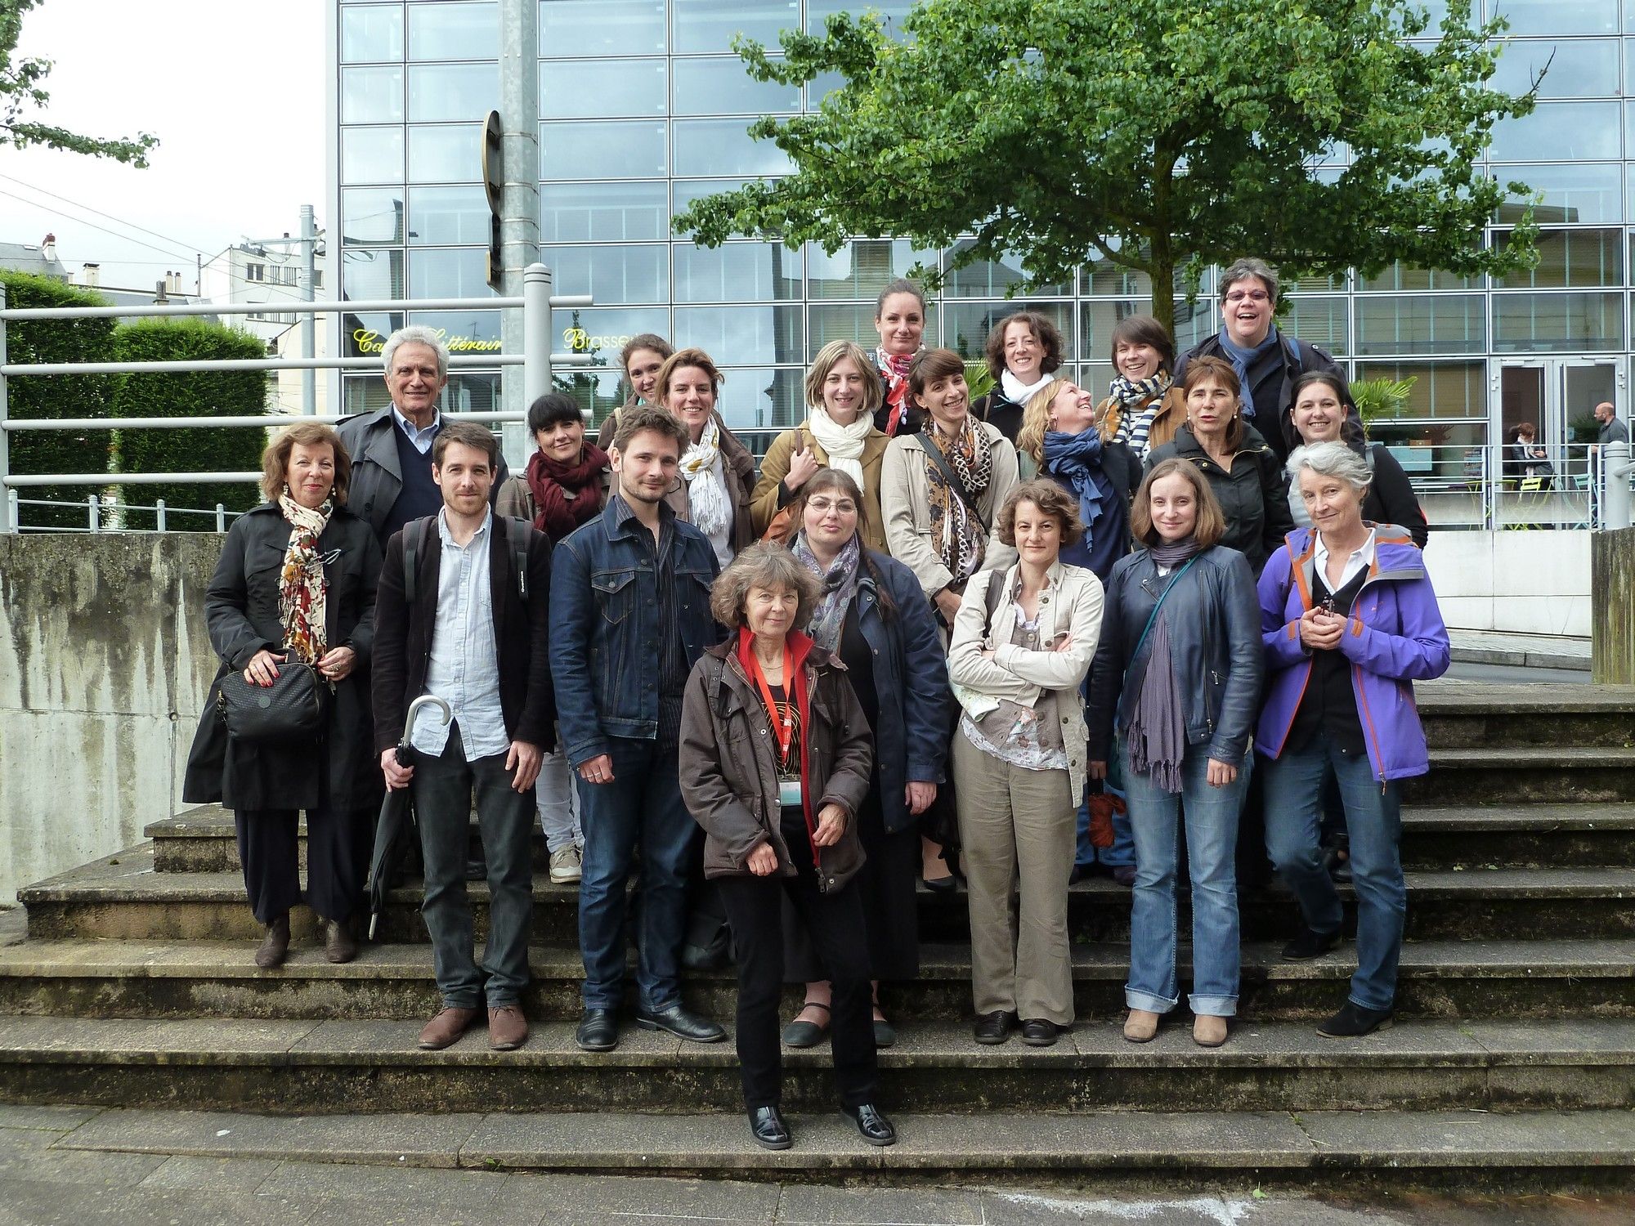
The Network
A national meeting /year
Two workshops: one in region ,
one in Paris (Musée)
Groups work on the selection of objects
Training, workshops, conferences
Mai 2016 à Limoges

Slide 21
What objects to preserve?
The contemporary scientific and technical heritage includes objects which are a material evidence of the major steps of progress in research, innovation and industrial activities.

Slide 22
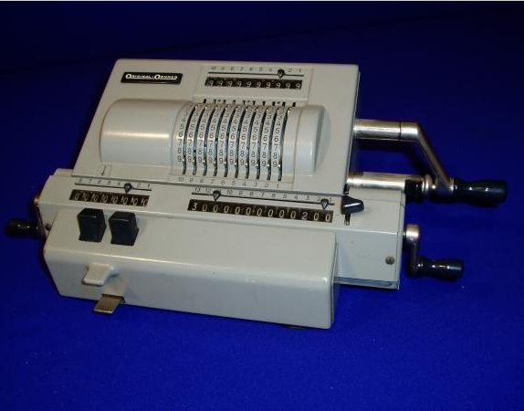
          Calculatrice mécanique (2083, ACONIT)
          Bugatti, Molsheim
1955- Région Rhône-Alpes, Grenoble
Fabricant : /Modèle : 239

Slide 23
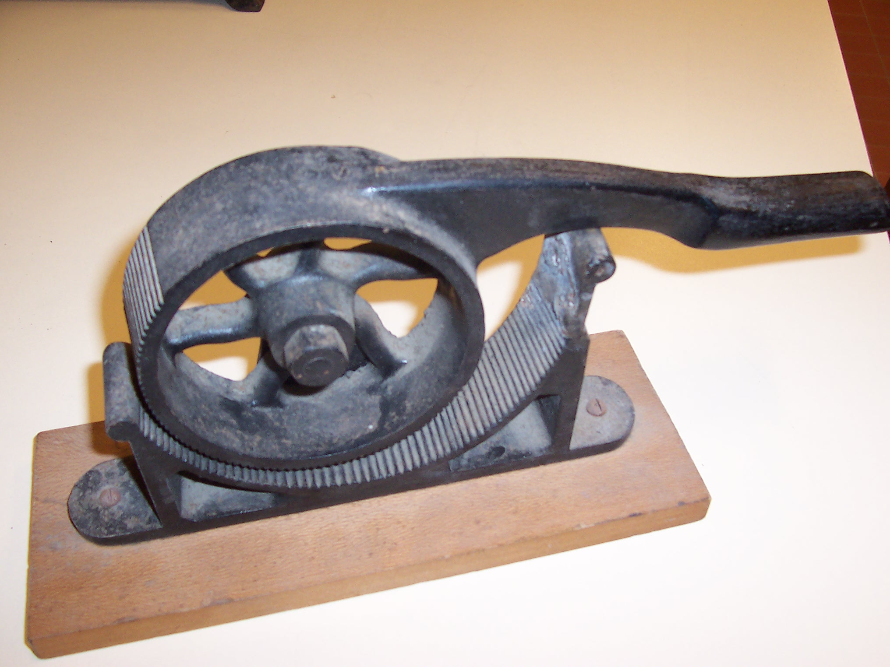
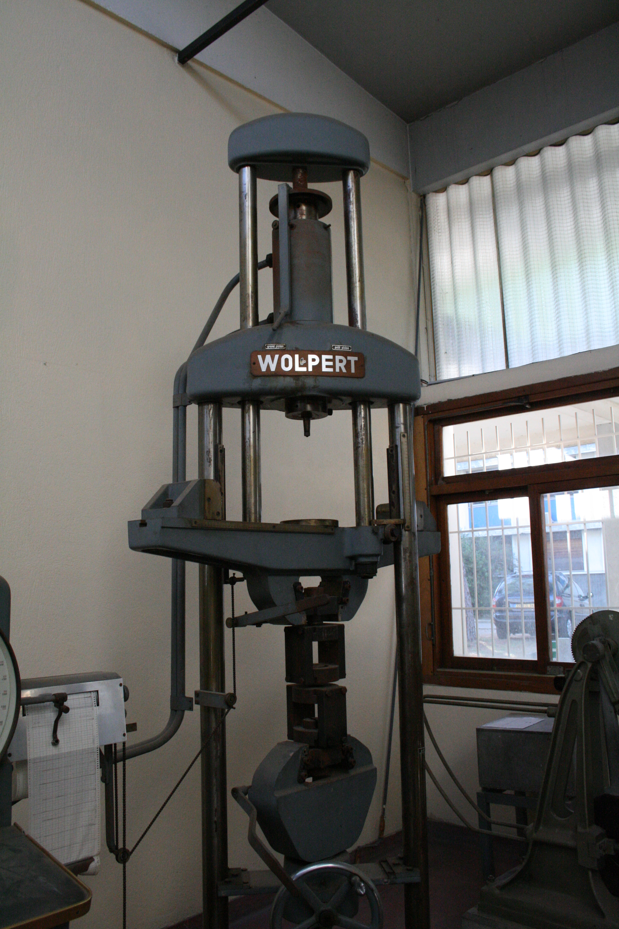
Compresseur de Cook
(compression des bouchons en chimie)
Région Bretagne
Machine de traction
(mesure de résistance des matériaux)
Région Languedoc-Roussillon

Slide 24
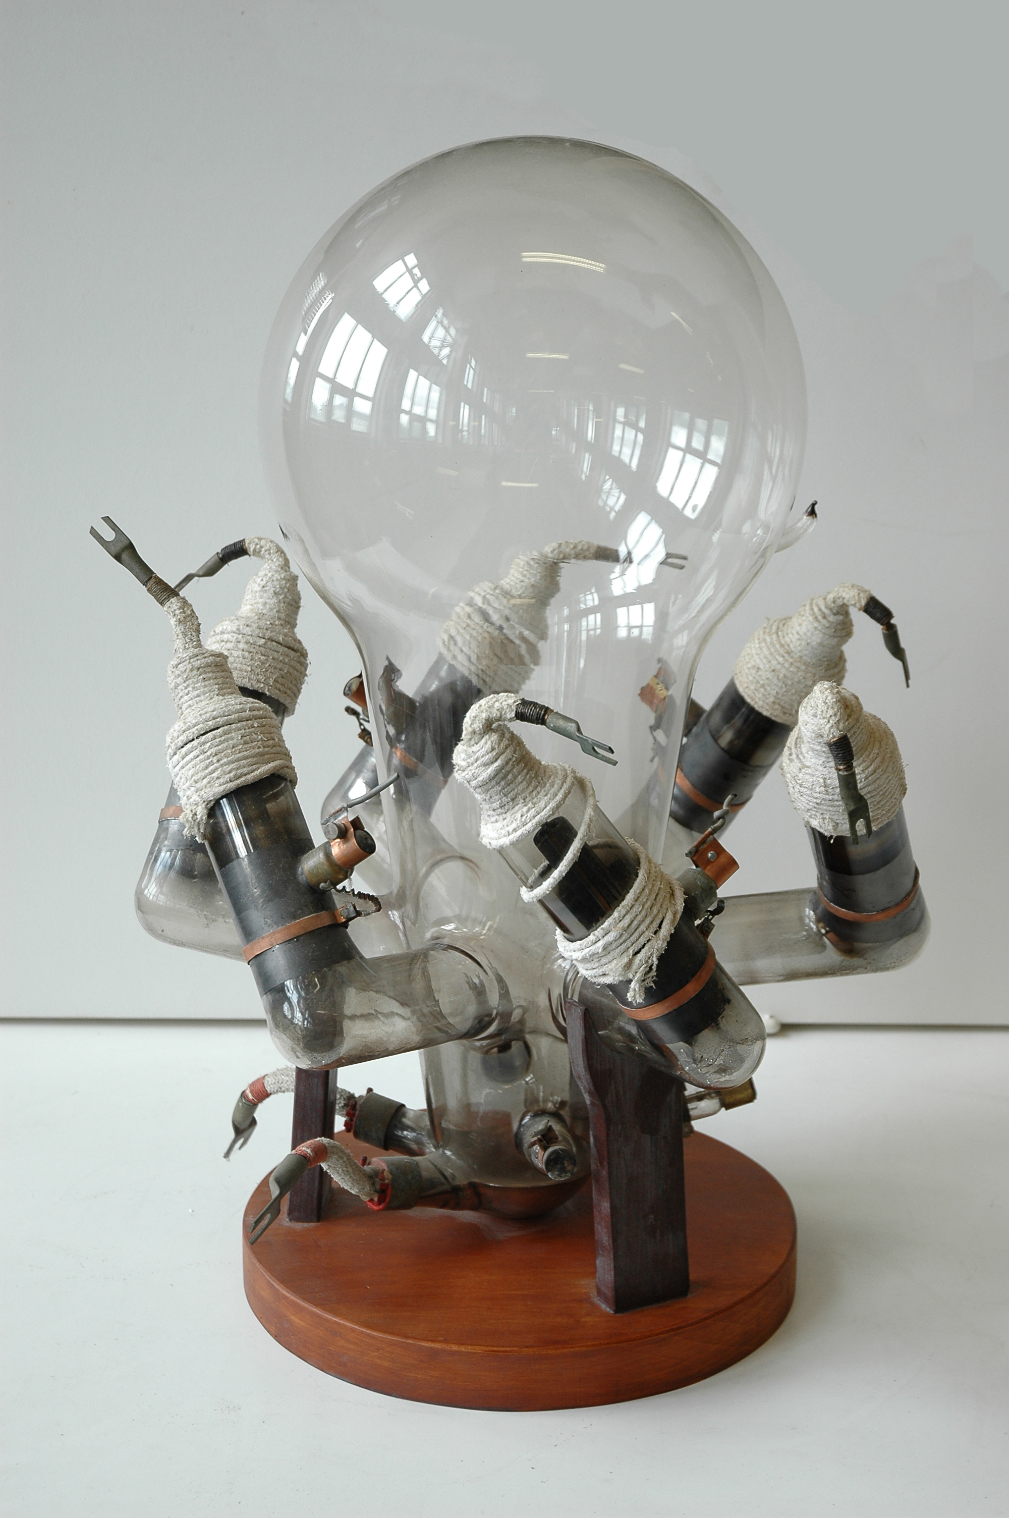
Redresseur hexaphasé de mercure
1950-1975
Région Pays de la Loire

Slide 25
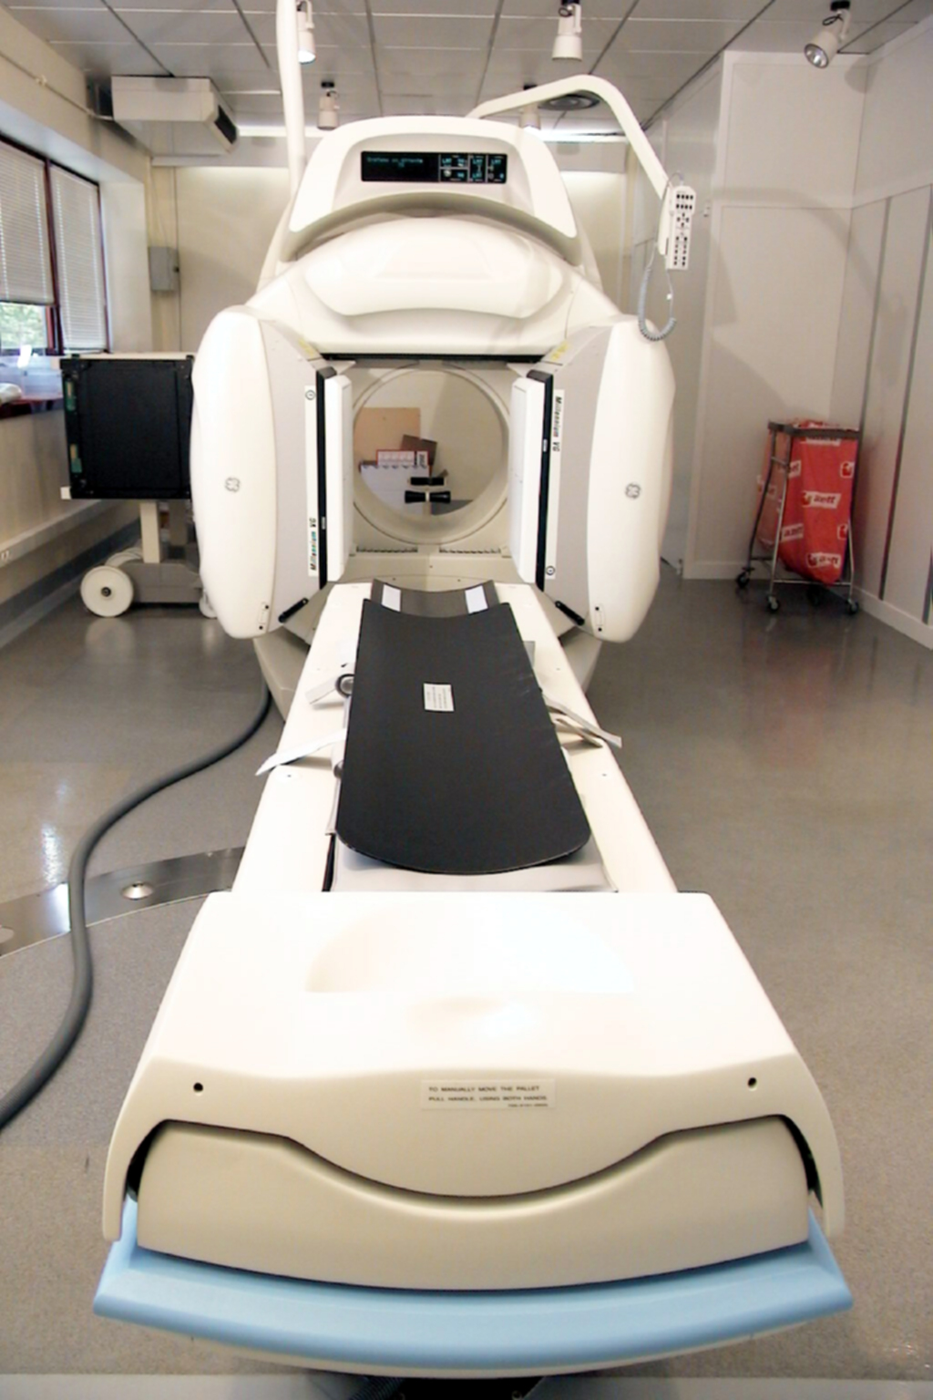
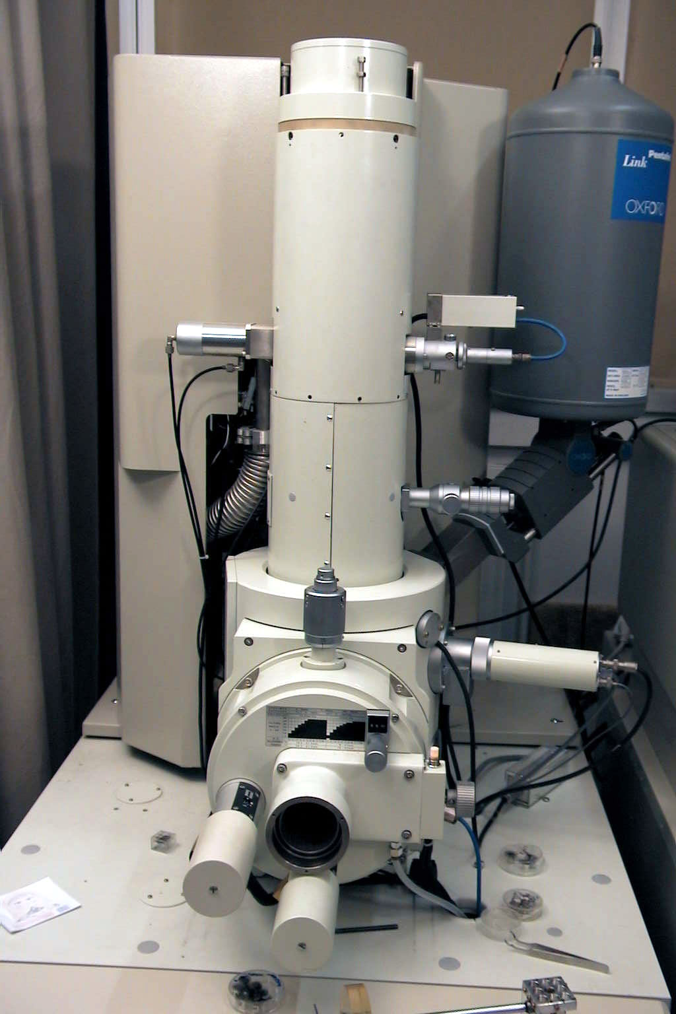
Microscope à transmission
Région Pays de la Loire
Gamma caméra Millenium
2000
Région Pays de la Loire

Slide 26
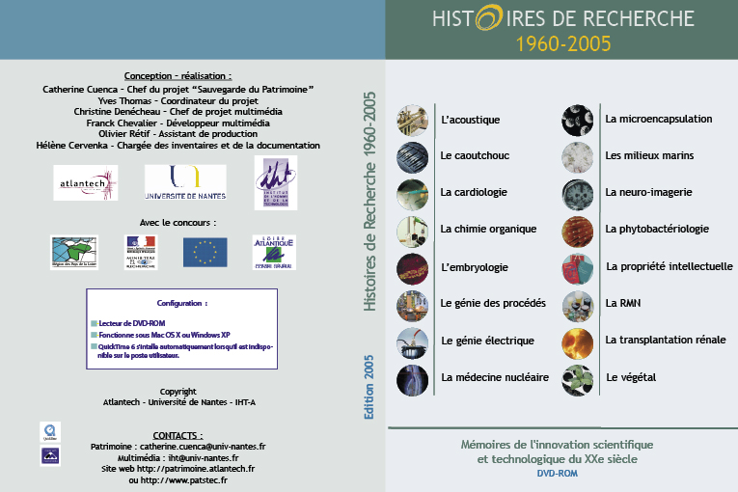
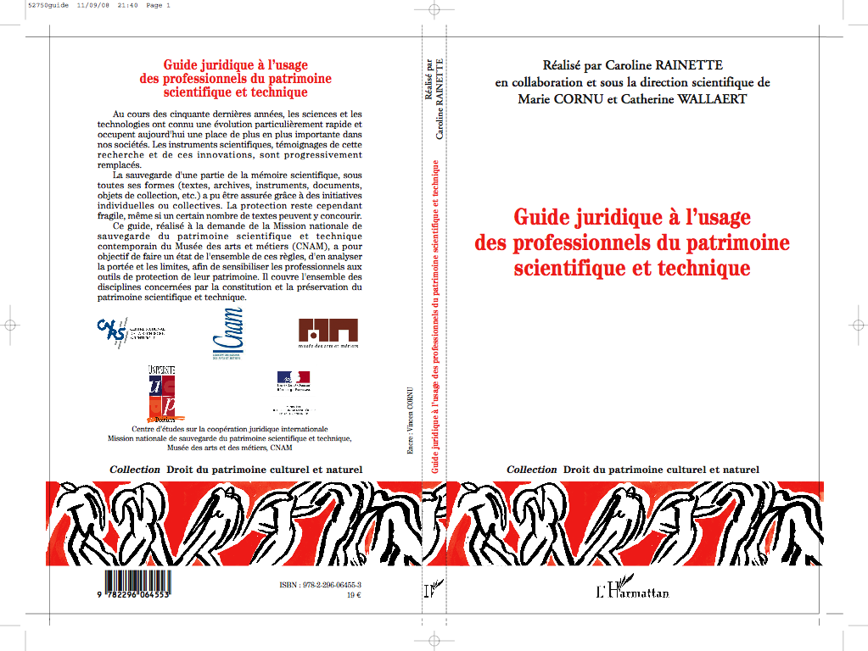
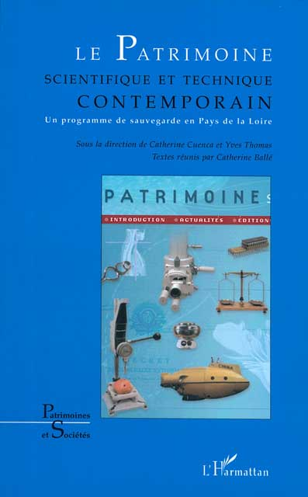
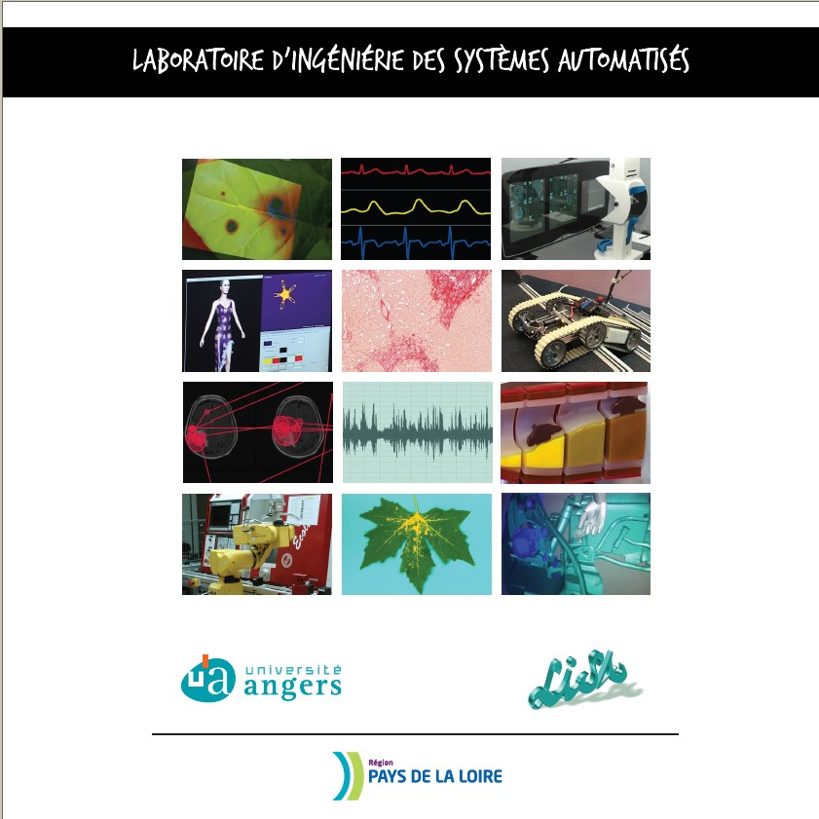
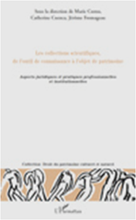
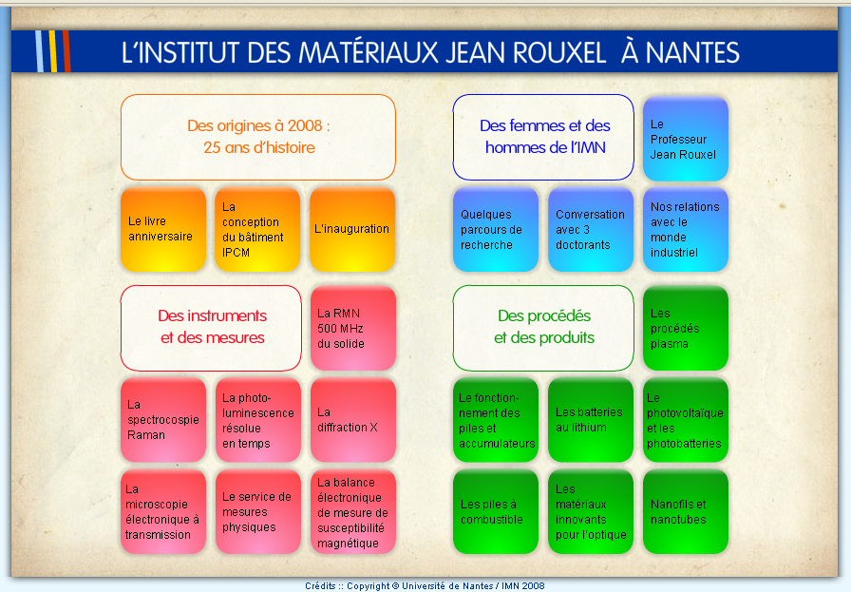
Publications: books, catalogues, DVD rom and tools for the network
Publications et éditions depuis 2006, dans des revues professionnelles
Ouvrages, catalogues d’expositions, DVD Rom….
Guide juridique

Slide 27
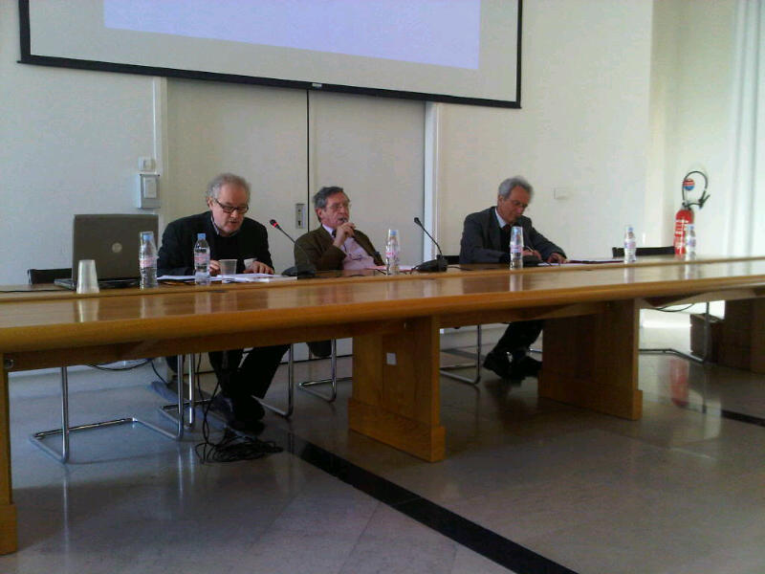
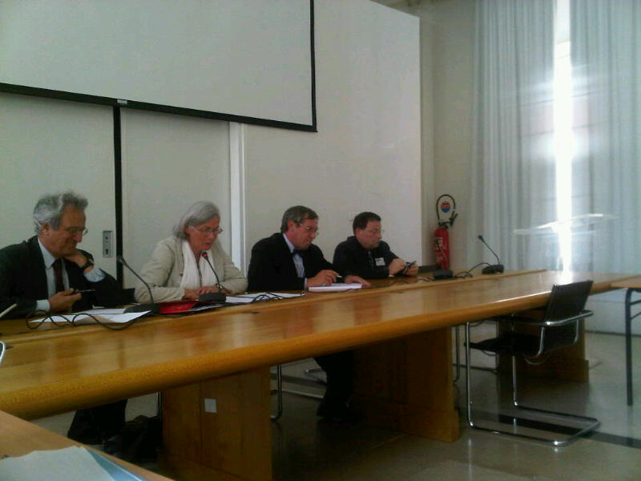
Research activities
  A research seminar on the topic to
  create a scientific community
  A scientific committee : Catherine Ballé, Serge Chambaud, Catherine Cuenca, Robert Halleux, Daniel Thoulouze

Slide 28
And the different « missions régionales Patstec » participate in research activities ou answer to the french or european calls.

Slide 30
Perspectives
Encourage to develop this national programme with international countries is now under way between partners, universities, museums

Slide 31
Network in Wallonie coordinate by Robert Halleux and Arnaud Peters : Université de Liège, Université de Namur, Université de Mons
PRIMECA, european programme, University of Clermont Ferrand and the région Mission Patstec Auvergne
A european network ESTHER (European Scientific and Technical HERitage) and the core of the network are scientific and technical national muséeums : Milan, Londres, Munich, Paris.
Opening to the international: with Canadiens, Portugais, MIT- Boston- Etats-Unis, les Australiens….
.
International

Slide 32
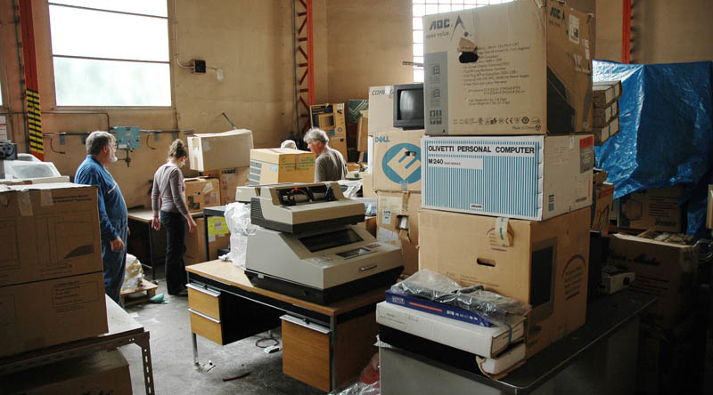
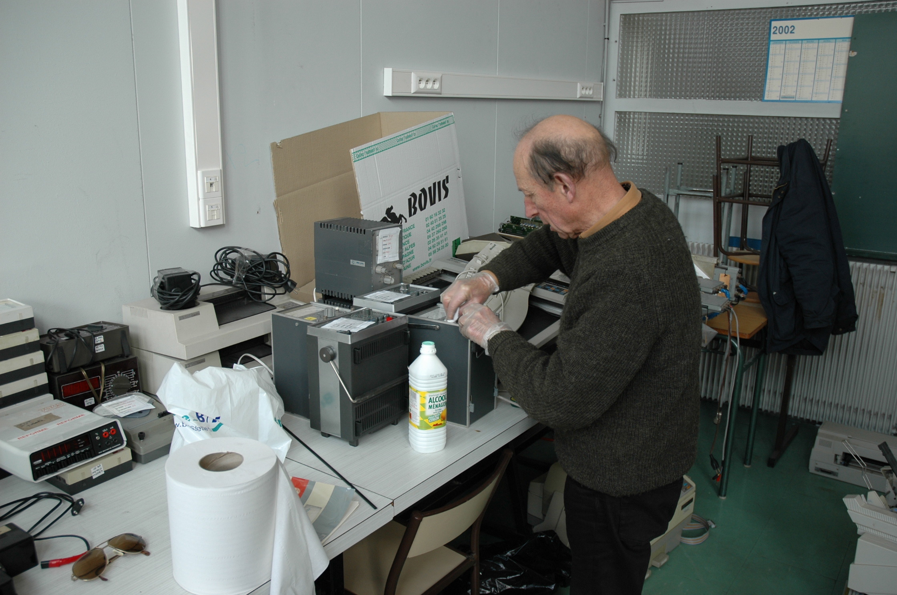
Steps of selections
in situ
at university

Slide 33
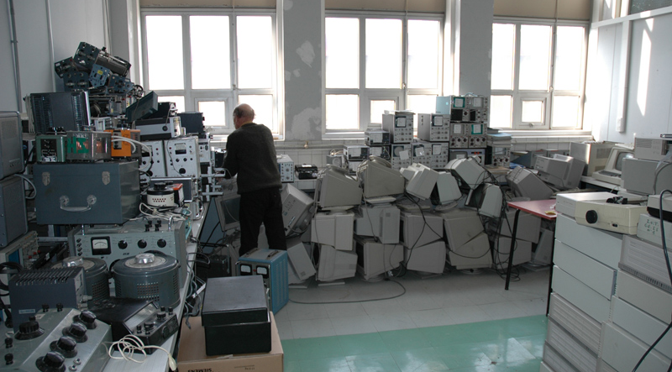

Slide 34
Thanks for your attention
catherine.cuenca@cnam.fr

Slide 35
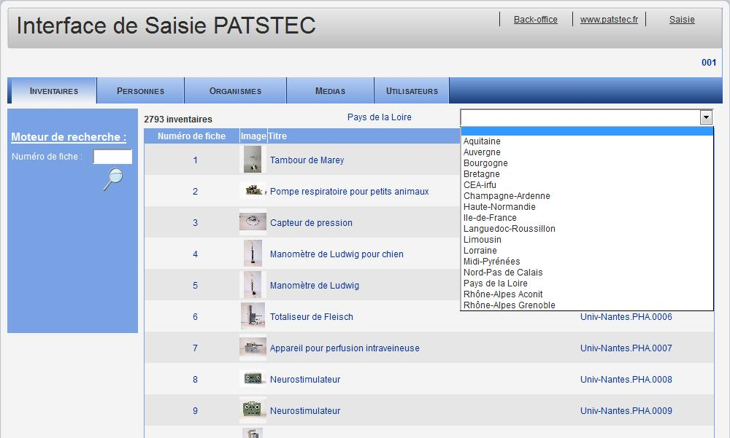
Sélection des régions

Slide 36
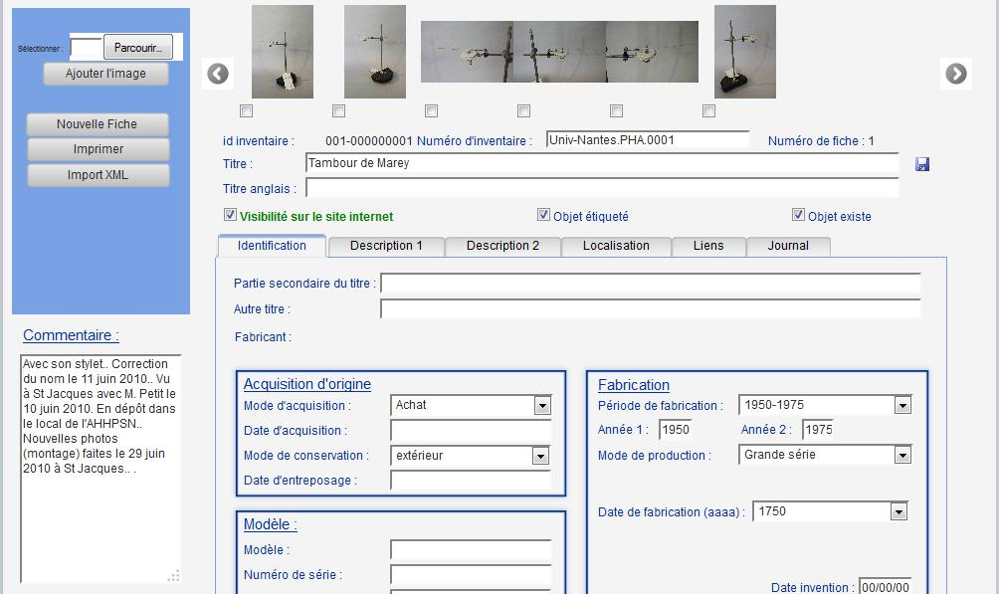
Fiche inventaire - identification

